Slide 1
Home Security System using Arduino UNO
By: Tanvi Johari (20BCE0619), Kaushik S. Prabhakar (20BCE0635), Ponnaganti Sahithi (20BCB0017),
Amrita Varier (20BCE2354)

Slide 2
Aim
To build a standalone, low-maintenance, affordable home safety system which protects users against various dangers like hazardous fires, intruders, and gas leaks. The system which consists of proximity, motion, smoke and temperature detection modules and also a servo motor for revolution of a fan is built using arduino uno microcontroller and C++ programming language.

Slide 3
Objective
The system will consist of 1 led, 1 buzzer and an lcd (i2c) as outputs. An ultrasonic sensor is used for proximity detection and a PIR sensor for motion detection. A temperature and gas sensor is used as inputs for detection of temperature and smoke. Additionally, we use a servo motor as an
actuator to showcase revolution of a knob on detection of fire as a sprinkler.

Slide 4
Existing System
The security of our homes currently majorly depend only on the lock and key model that is being used to secure our homes and safeguard our belongings but it has various disadvantages like lock picking, etc. so a new and revised system for the security of our homes must be introduced.
As a part of the literature survey for the same, few papers were studied by us and the systems proposed in those are as follows:
Smart Home Security System Using IoT
This paper describes a low-cost GSM smart home security system along with features like face recognition and detection. The system not only monitors sensor data but also sends alerts when any form of intrusion happens. The PIR sensor will activate camera only when intrusion is detected thus saving memory and power. The system will compare the face of the intruder with predefined database of all authorised people’s face images. In this way, the system not only allows authorised people to enter but also it can be operated from anywhere in the world.

Slide 5
Existing System
Design and implementation home security system and monitoring by using wireless sensor networks WSN/internet of things IoT
The system proposed in this paper can be used to sense a wide range of things including body temperature, humidity, gas, object motion. Various sensors and devices used for this purpose include: - Arduino processing unit, Raspberry pi 3 mode B, Spark photon, RFID system, PIR sensor. The door lock is password protected and if the password entered is correct then the motor opens the door. The system allows only three incorrect chances after which it goes into a short cooldown period. The PIR sensor sets up motion detection which can be used by owners to monitor suspicious movement. A RFID system is also present for card-based authentication. An interactive app has been developed to warn the owners of any suspicious activities.

Slide 6
Existing System
Home Security against Human Intrusion using Raspberry Pi
The system proposes a method which aims to make photos of intruders more clear and properly visible. A smart mirror is designed which will provide both information and security. Yolo technique is used for human detection in this scenario. Although the accuracy of human detection using Yolo technique is considerably quite good, the main problem is to identify intruder during back view or complete side view.
Intelligent Home Security Surveillance System Based on ZigBee:
An intelligent remote monitoring system for home security based on ZigBee technology and GSM / GPRS network is proposed in this paper. The experimental results show that the system can attain remote surveillance of intelligent home safety with high availability and reliability. It can completely meet the normal home environment for the communication needs, with a low power therefore, as a whole it is very suitable for family use.

Slide 7
Existing System
Smart Home Security System Based on Zigbee
The proposed system consists of a hub, a battery powered sensor node and an Android application. The sensor node sends sensor output to the hub via Zigbee. If any kind of intrusion, flood or smoke is detected, the hub will start an alarm and triggers the Android application to display an alarm in real time through the Internet via Firebase. If an intruder is detected, his photo will be taken and processed via a predefined software using haar algorithm where his face will be detected and compared with existing database. All features of the face will be extracted and given as input to the algorithm and distance is calculated and kept for future use. The system not only grants or denies permission but also provides live mobile monitoring.
Smart doorbell system based on face recognition
This paper mainly discusses about how to recognise a face. This project uses the Eigenfaces algorithm using OpenCV library to perform face recognition. Face recognition is very important for security. For evaluating the proposed system, the authors use two analysis algorithms which include Eigen face and Independent Component Analysis (ICA). The system proposed here will aid people having hearing impairment or who are completely deaf, to get intimated about someone on the door

Slide 8
Existing System
IOT based smart security and home automation
This project mainly builds a home automation system which is wireless. Arduino uno is used to achieve security. Different sensors are used to detect abnormality and if it is found then the concerned person will be warned. The present status of the place can be monitored using this system even when the owner is far from home. It further enhances security by using encryption and decryption of data. The current data can be used for intruder detection, fire accidents etc.
The authorised person gets the image of the intruder via sms or email. Also, the count of the number of people who visited the house is obtained.

Slide 9
Issues with Existing System
It has been found that using lock and key doesn’t keep away cases of robbery and thefts. An ideal security system should be reliable and robust. It should have various fail safe mechanisms and a backup system so that even if a particular safety measure fails, the other can be used. But, the traditional lock and key model is not robust, reliable, scalable or fail safe. Thus, we need to come up with a model which satisfies the criteria of an ideal security system.
From the literature survey, it can be concluded that an intelligent system consisting of multiple components all connected to a microprocessor can be used to better the current situation.
One of the most ideal factors that matters while choosing a security system is cost. Most of the security systems seen are very costly and difficult to set up without proper interference of expert personnel. So, our proposed system plans to present a system that is affordable to everyone, without compromising functionality.

Slide 10
Proposed System
In this section, we introduce our home security system with various devices like sensors, LCDs, etc. paired with an Arduino UNO to provide users with various alerts to protect their home.

Slide 11
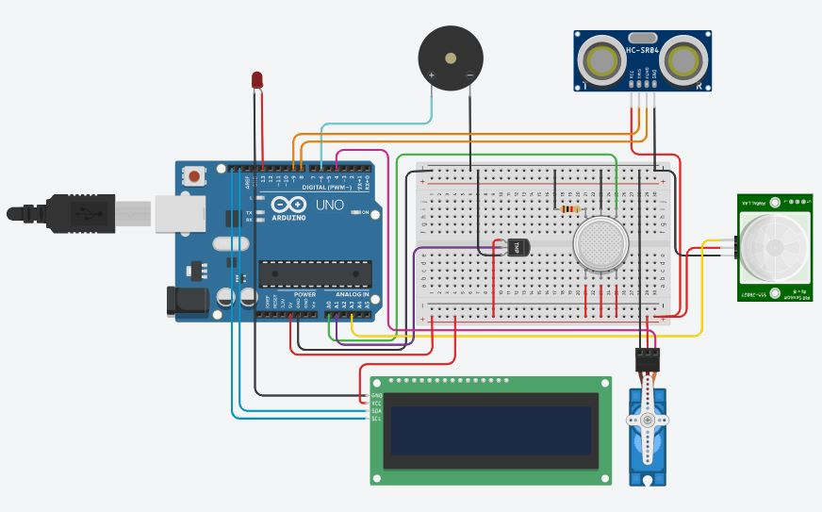
Proposed System - Design

Slide 12
Components
LED
Piezo
Ultrasonic Sensor
PIR Sensor
Gas Sensor
Temperature Sensor
Servo Motor
LCD I2C
Arduino UNO
The LED glows as part of the alert system
The buzzer sets off as a part of the alert system
The distance sensor detects when a safe door is opened
This sensor detects motion (intruder alert)
This sensor is used for smoke detection & its concentration
This sensor is used to detect high temp & fire
It acts a knob that starts a sprinkler after fire is detected
It acts a monitor to show messages to the user
This microcontroller controls all the components

Slide 13
Modules
Smoke Alert
When the gas sensor detects a gas with a PPM (parts per million) above 150 and the temperature detected is not above 75°C, the alarm sets off and the LCD displays “Smoke Detected!!” along with the concentration of the gas.
This keeps happening until the concentration level dies down to below 150 PPM when the buzzer stops and LCD goes to blank state.
High Temperature Alert
When the temperature detected by the temperature sensor exceeds 75°C and no smoke is detected, the Piezo buzzer is set off and the LCD displays “Fire Alert!!” along with the current temperature of the room in °C.
This happens until the temperature decreases to below 75°C when the alarm stops and the LCD does not display any message.

Slide 14
Modules
Fire Alert
When the gas sensor detects a gas with a concentration above 150 PPM and the temperature detected is above 90°C, the alarm sets off, LED starts blinking, and the LCD displays “Fire Detected!! Starting sprayer” indicating the start of the motor for the sprinkler system.
This message is displayed till at least one of the above conditions are not satisfied anymore when the buzzer and LED stop and LCD goes to blank state.
Robber Alert
When the ultrasonic distance sensor detects the distance as more than 60cm (the assumed depth of a standard safe), the alarm sets off, the LED starts blinking, and the LCD displays “Thief Detected!!”.
This continues till the safe is closed when the buzzer and LED stop and LCD goes to blank state. Users can disable this feature manually before opening the safe.

Slide 15
Modules
Intruder Alert
When the PIR sensor detects movement based on IR radiations by humans or animals, the alarm sets off, the LED starts blinking and the LCD displays “Intruder Detected!!”.
The user can set the system to enable the sensor during night hours to avoid false alarms like movement of family, etc.
The alarm system goes on until movement has stopped or the system shuts down forcefully, when the buzzer and LED stop and LCD goes to blank state.

Slide 16
Working Screenshots

Slide 17
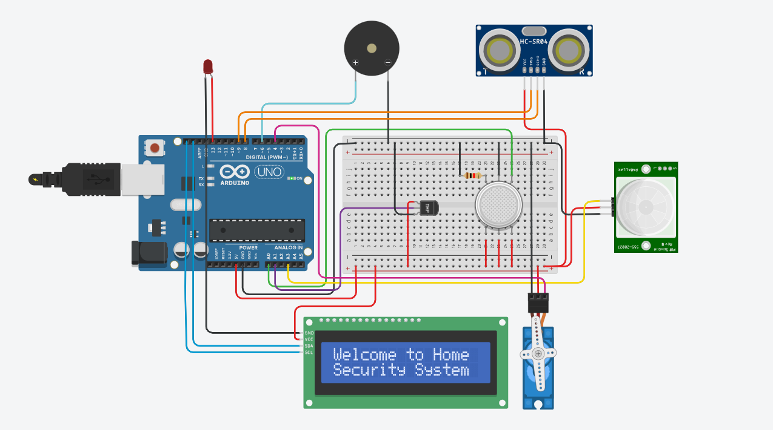
Initialization

Slide 18
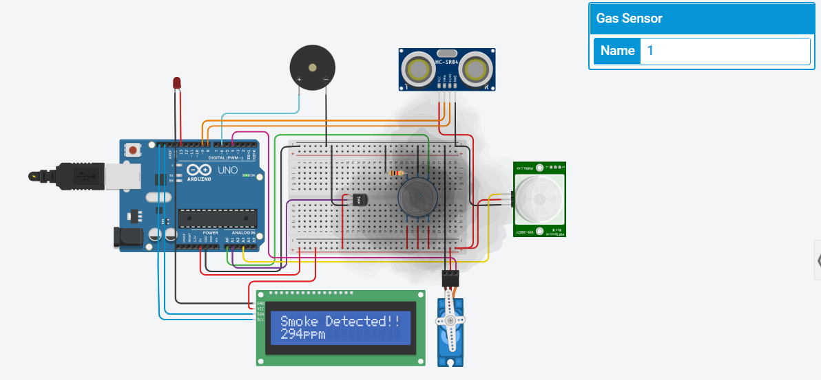
Smoke Alert

Slide 19
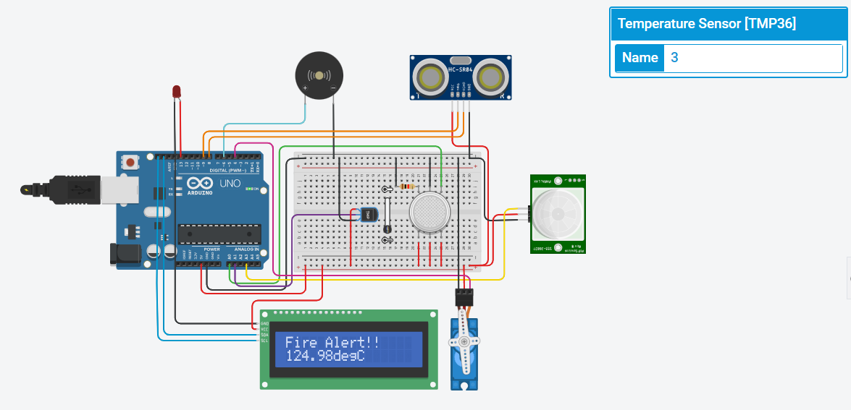
High Temperature Alert

Slide 20
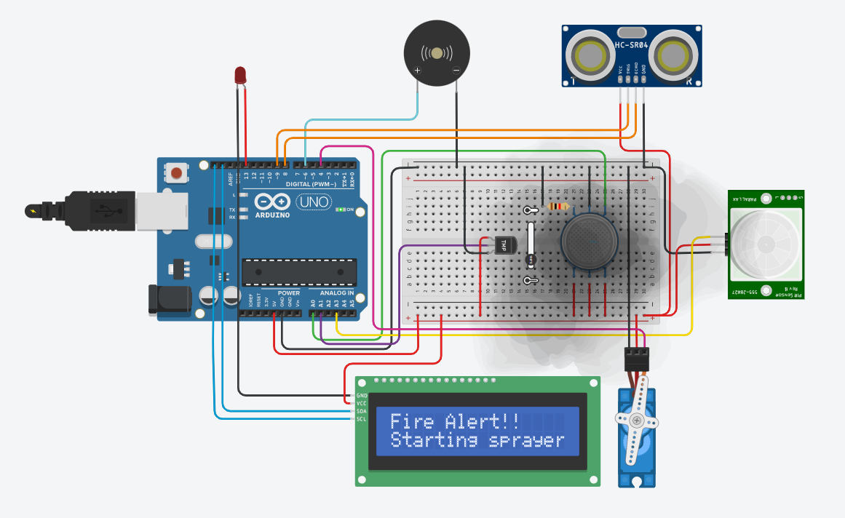
Fire Alert

Slide 21
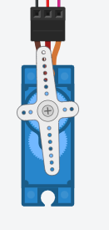
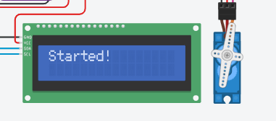


Sprinkler

Slide 22
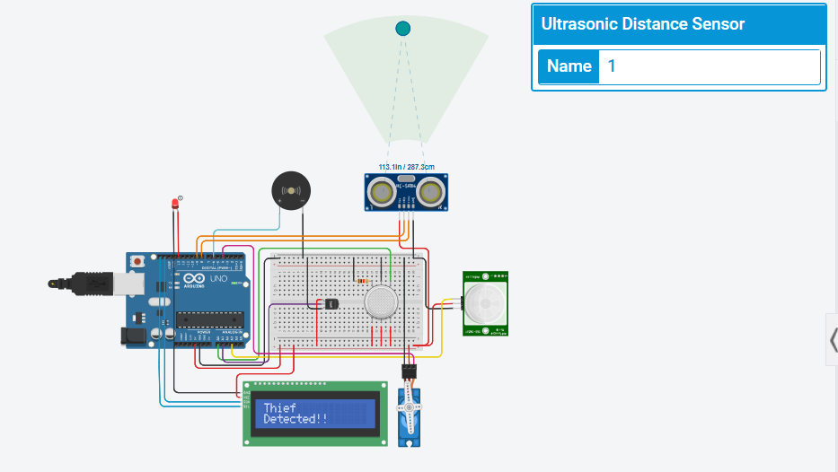
Robber Alert

Slide 23
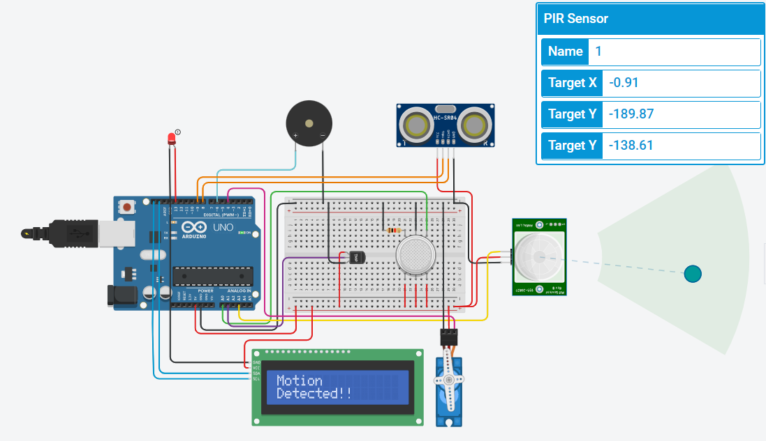
Intruder Alert

Slide 24
Conclusion & Future Enhancements
The system was constructed successfully and produced the desired results. This system is low cost, needs low maintenance, and is an easy to set system for home security using IOT.
There is scope for a development of a mobile phone companion app where any incidents can be logged to a database. Additionally, using a time and date module, incidents can be time-stamped and the security system can be configured to operate during certain time intervals and/or a certain day. Moreover, live alerts can be sent to the user through mobile phone notifications through the companion app.
With increasing technology more improvements can be made to this device to suit the needs of the user and help make their home more secure and protected.

Slide 25
References
[1] P. Prathibha , Alok Kumar , Abhay Singh , Kumari Parul , Shubham Jaiswal, “Smart Home Security System Using IoT”, IJRESM| May 2020
[2]H. H. Qasim, A. E. Hamza, L. Audah, H. H. Ibrahim, H. A. Saeed, M. I. Hamzah, ”Design and implementation home security system and monitoring by using wireless sensor networks WSN/internet of things IoT”, Research Gate |June 2020
[3]Raju A Nadafa, S.M. Hatturea, Vasudha M Bonala, Susen P Naikb, “Home Security against Human Intrusion using Raspberry Pi” , Research Gate| January 2020
[4]Jun Hou, Chengdong Wu, Zhongjia Yuan, Jiyuan Tan, Qiaoqiao Wang, Yun Zhou, “Intelligent Home Security Surveillance System Based on ZigBee” , Research Gate | December 2008
[5] Chua Boon Liang, Mujahid Tabassum, Saad Bin Abul Kashem, Zulfiqar Zama, P. SureshU. Saravanakumar,”Smart Home Security System Based on Zigbee”, Research Gate| January 2021
[6]Udit Chaudhari, Sushmita Gilbile, Gayatri Bhosale, Nishigandha Chavan and Prashant Wakhare, “Smart doorbell system based on face recognition” ,International Journal of Scientific Research in Science and Technology| May 2021
[7] Daneshwari Jotawar, Kaveri Karoli, Mohanrao Biradar, Nyakantiew Pyruth, “IOT based smart security and home automation”, International Research Journal of Engineering and Technology (IRJET)| Aug 2020

Slide 26
Thank You

